Slide 1
CSE326 Internet Programming Laboratory Lecture #8
Dr. Navneet Kaur

Slide 2
Outline
Tables in HTML
Rowspan and Colspan
CSS on tables
Hoverable tables

Slide 3
Tables in HTML
A table is a structured set of data made up of rows and columns (tabular data).
<table>
…
</table>

Slide 4

Tables in HTML
</td>
</td>
</td>
</td>
</td>
</td>
</th>
</th>
</th>
</th>
</th>
</th>
<tr></tr>
<tr></tr>
<tr></tr>
<tr></tr>
<thead></thead>
<tbody></tbody>

Slide 5
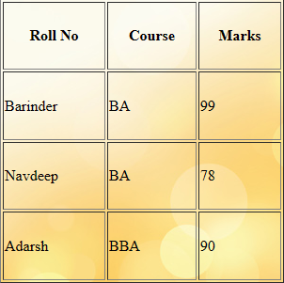
Tables in HTML

Slide 6



Rowspan and Colspan
To make a cell span over multiple rows, use the rowspan attribute.
To make a cell span over multiple columns, use the colspan attribute.
colspan=“2”
colspan=“2”
rowspan=“2”
rowspan=“2”

Slide 7
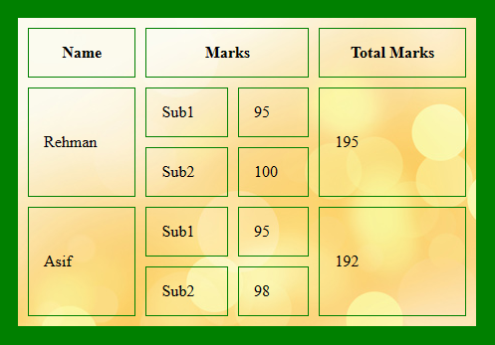
Rowspan and Colspan

Slide 8
CSS on tables
height
width
padding
text-align
color
background-color
background-image
borders
border-collapse

Slide 9
Hoverable tables
To highlight rows:
tr:hover{
}
To highlight cells:
td:hover{
}

Slide 10
Hoverable tables
To highlight table:
table:hover{
}

Slide 11
References
https://www.w3schools.com/html/html_tables.asp
https://www.w3schools.com/html/html_table_colspan_rowspan.asp
https://www.w3schools.com/css/css_table.asp
https://www.w3schools.com/css/css_table_size.asp
https://www.w3schools.com/css/css_table_align.asp
https://www.w3schools.com/css/css_table_style.asp
https://www.w3schools.com/css/tryit.asp?filename=trycss_table_hover

Slide 12
Program link
Tables in HTML -> https://onlinegdb.com/cePewJrnH
Rowspan and Colspan -> https://onlinegdb.com/a214YPluKN
CSS on tables/Hoverable tables -> https://onlinegdb.com/EI0rOKsJ7
Striped table -> https://onlinegdb.com/2e-xmsZ0y

Slide 13
Thank you

